Slide 1
《群书治要》：
构建人类命运共同体的智慧指南
刘 余 莉

Slide 2
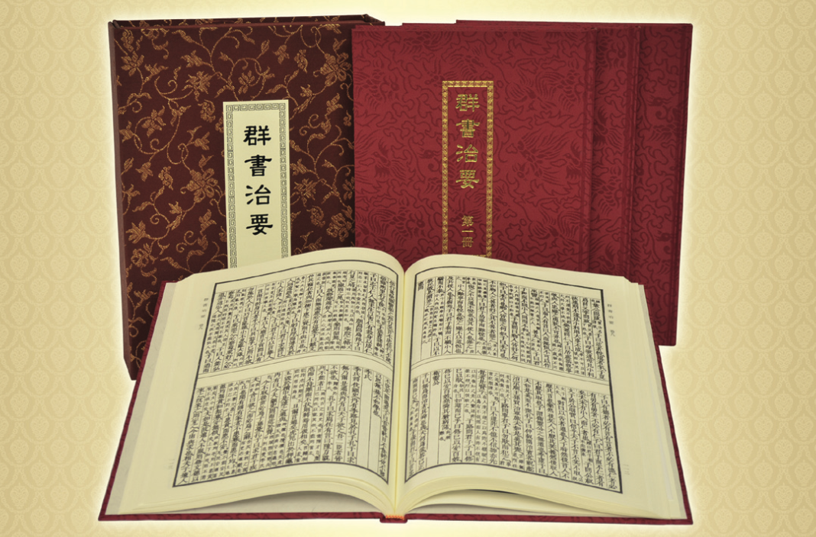

Slide 3
人类的生存没有比今天更危险的时代了。这种对人类生存的威胁，是人类自己招致的。如果人把自己的技术滥用于利己主义、邪门歪道和罪恶目的，就有致命的危险。正因如此，它才远比地震、火山爆发、暴风、洪水、干旱、病毒、细菌，还有鲨鱼和猛虎，更加危险。
——汤因比

Slide 4
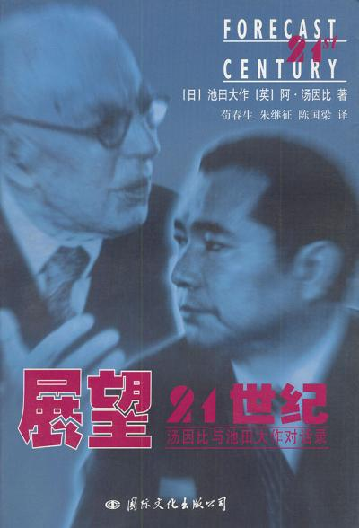
能够真正解决二十一世纪社会问题的，唯有中国的传统文化。

Slide 5
“构建人类命运共同体”，是习主席解决当今世界各种难题、消弭全球各种乱象的“中国方案”。

Slide 6
2013年3月，习主席在莫斯科国际关系学院发表演讲，第一次向世界传递了他对人类文明走向的基本判断：
“这个世界，各国相互联系、相互依存的程度空前加深，人类生活在同一个地球村里，生活在历史和现实交汇的同一个时空里，越来越成为你中有我、我中有你的命运共同体。”
首次向世界阐述他的“全球观”。

Slide 7
习主席在2017年12月1日的演讲中说：“人类命运共同体，顾名思义，就是每个民族、每个国家的前途命运都紧紧联系在一起，应该风雨同舟，荣辱与共，努力把我们生于斯、长于斯的这个星球建成一个和睦的大家庭，把世界各国人民对美好生活的向往变成现实。”

Slide 8
《群书治要》的宇宙观：
一体

Slide 9
Loving and respecting our parents and siblings, are they not fundamental to the actualisation of human goodness?
—— Analects of Confucius
君子务本，本立而道生，孝弟也者，其为仁之本与？
—— 《论语·学而》
Notes:
As the Analects of Confucius stated, ‘Loving and respecting our parents and siblings, are they not fundamental to the actualisation of human goodness?’

Slide 10
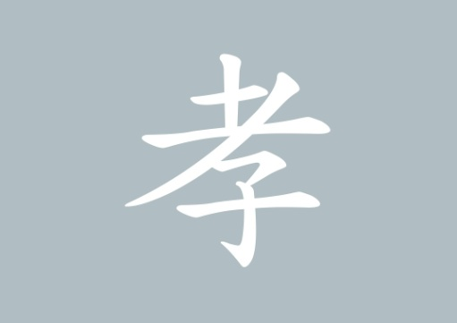
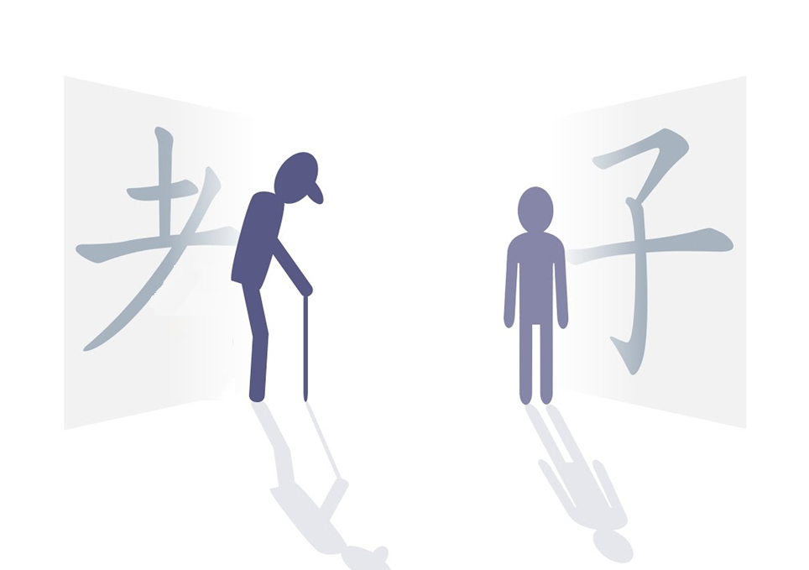
old child
Notes:
Let us take a look at the Chinese character for filial piety (孝). On the top of it, there is an abbreviated form of the character for old (老). At the bottom, there is a character for child (子).

Slide 11
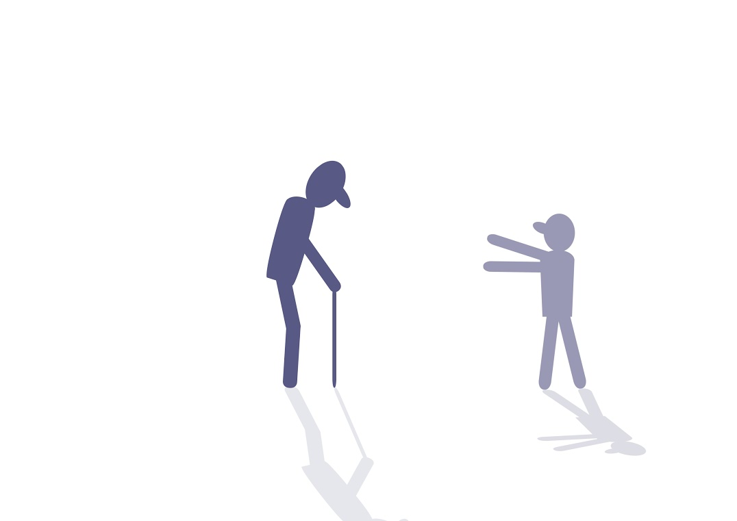
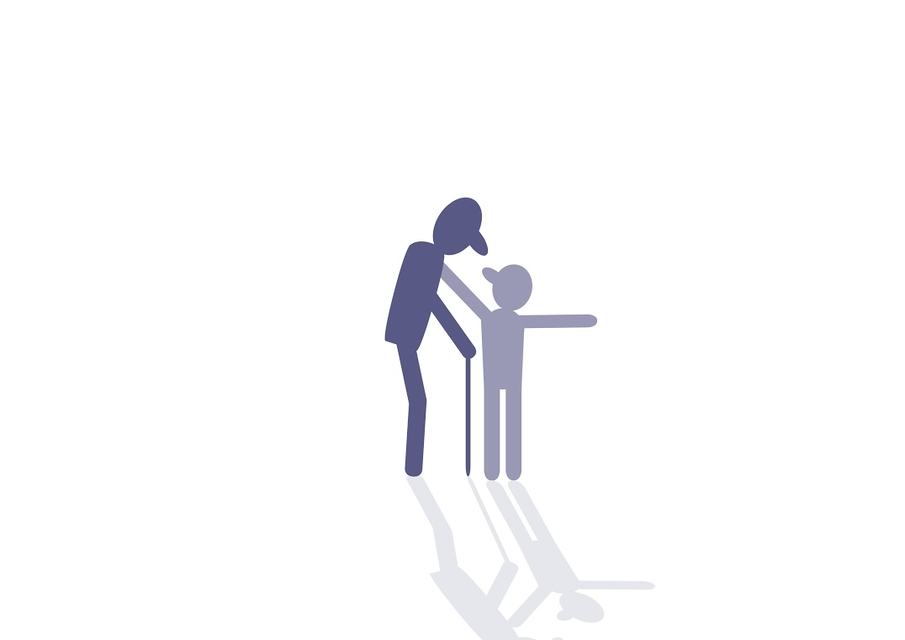
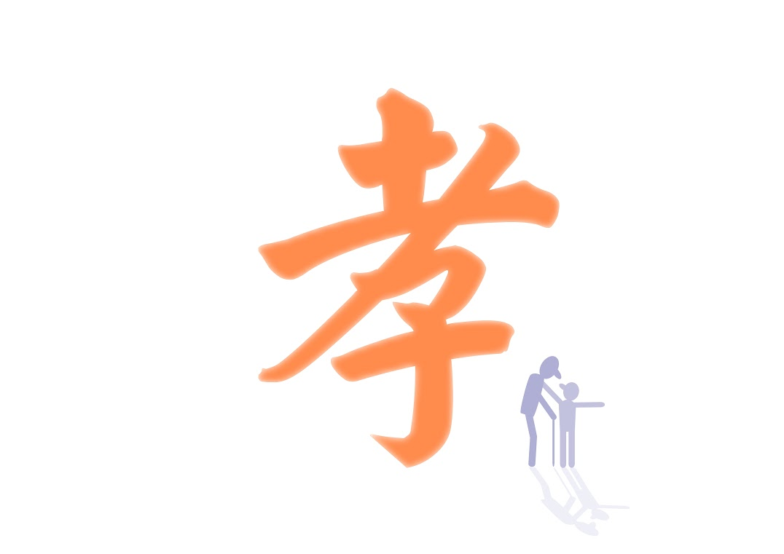
Filial piety
Notes:
When combined, it means that the older generation and the younger generation are one entity. However, there are infinite generations in the past and infinite generations to come.
This character indicates that the different generations are one entity.

Slide 12
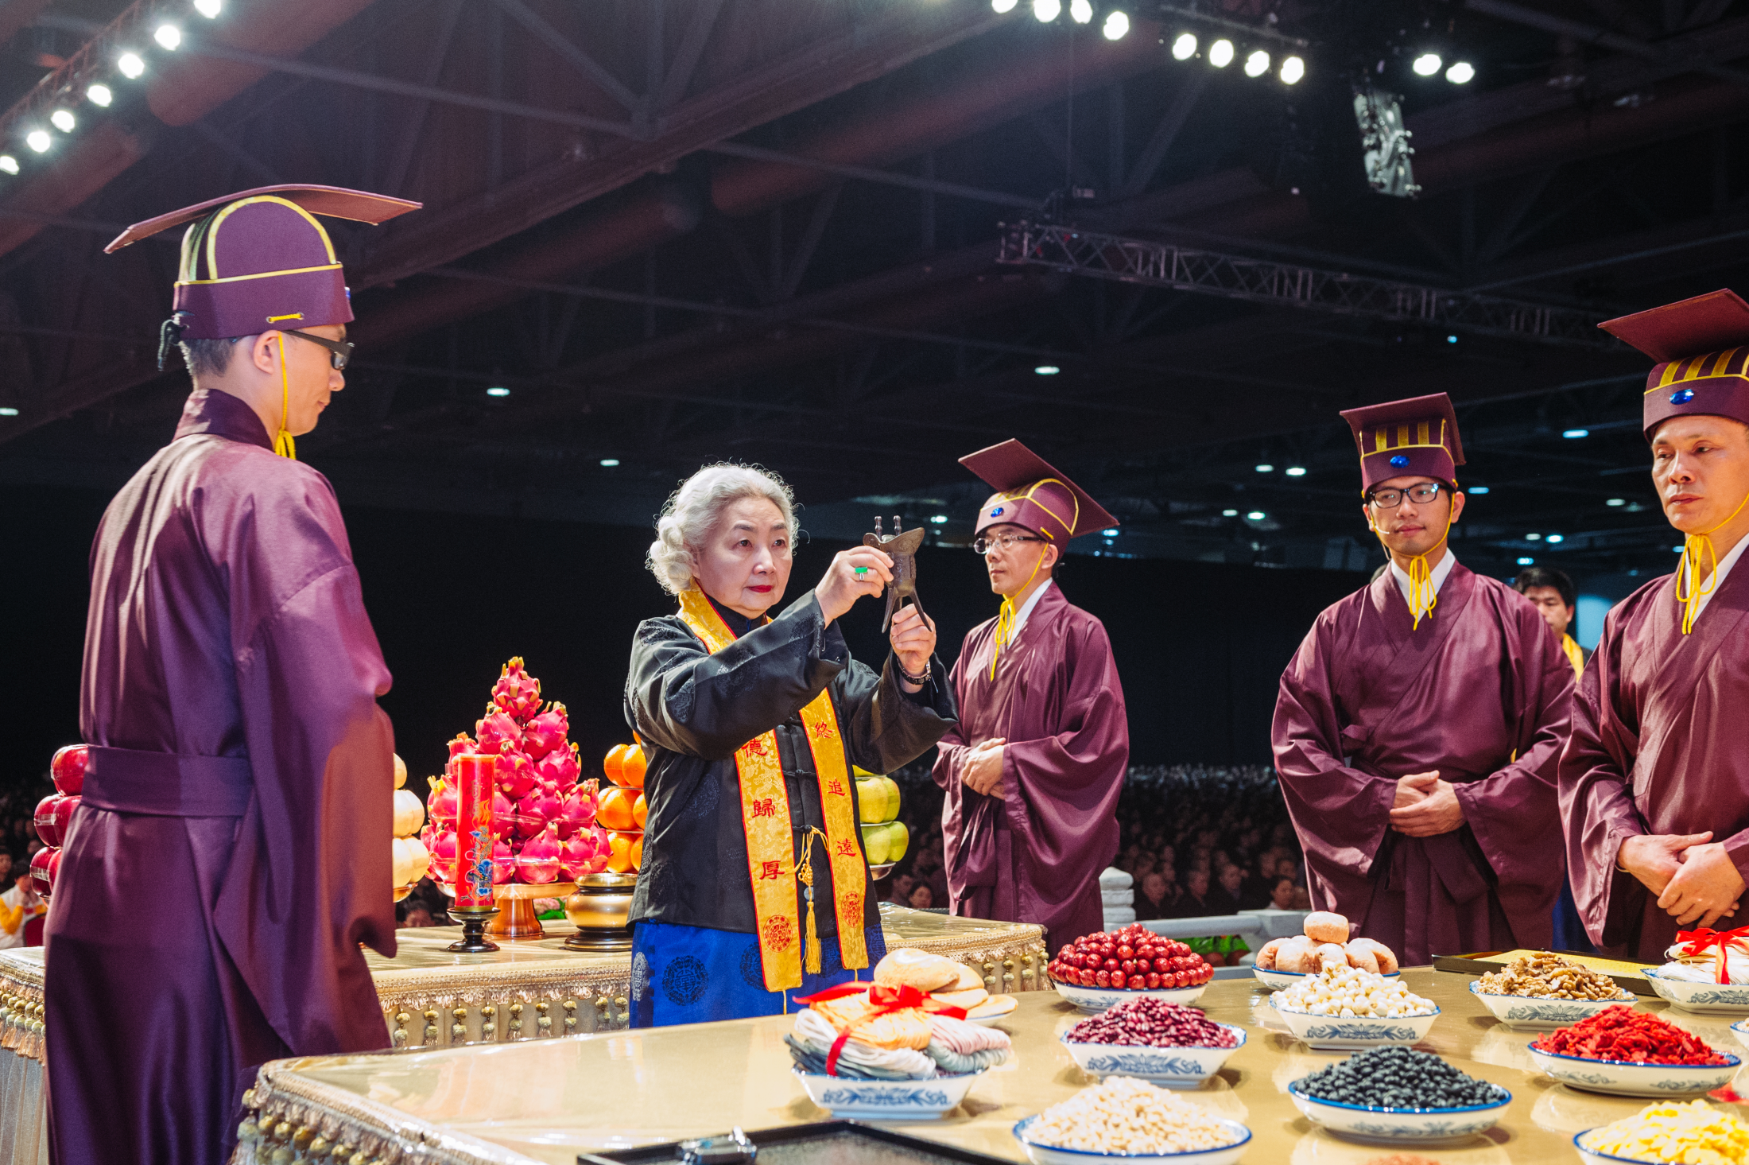
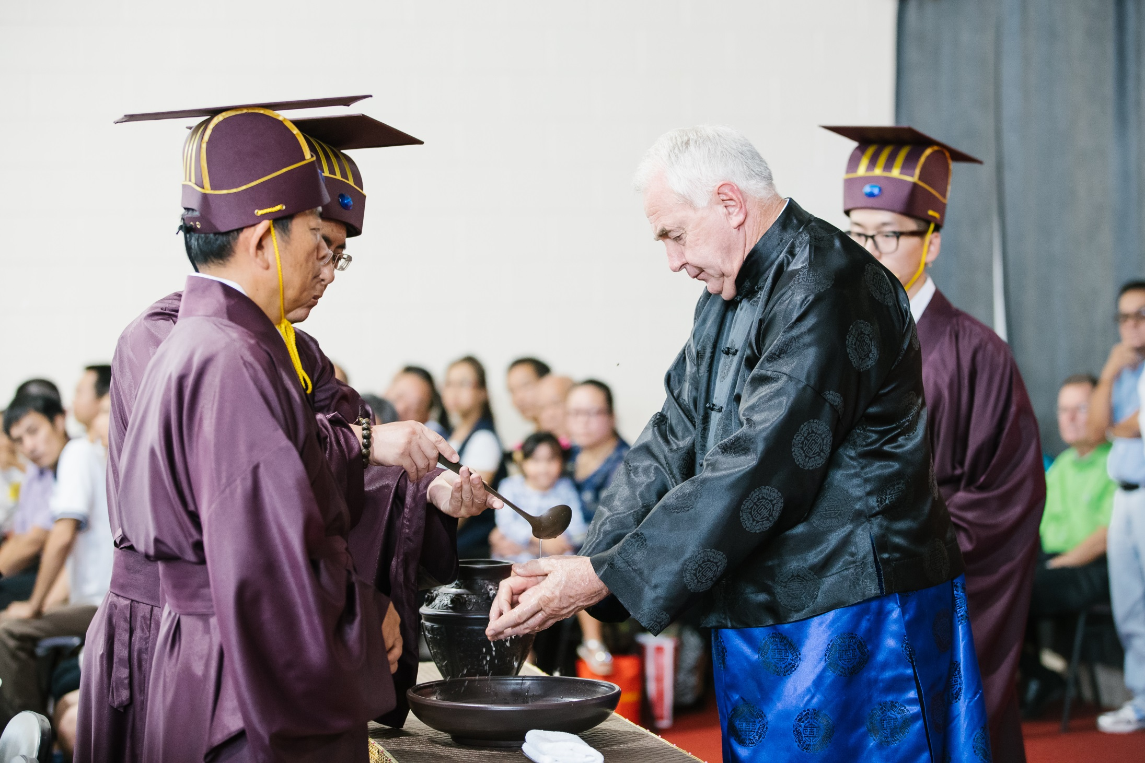
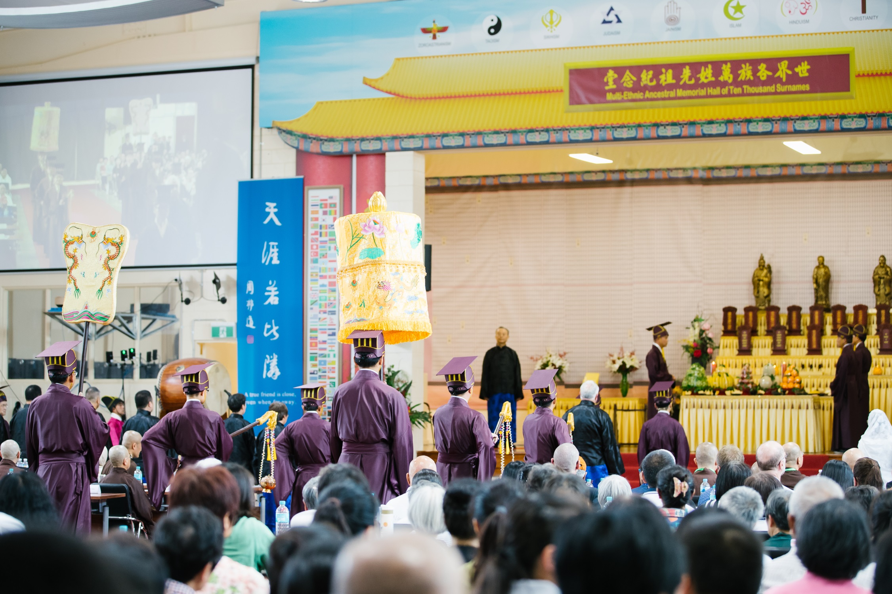
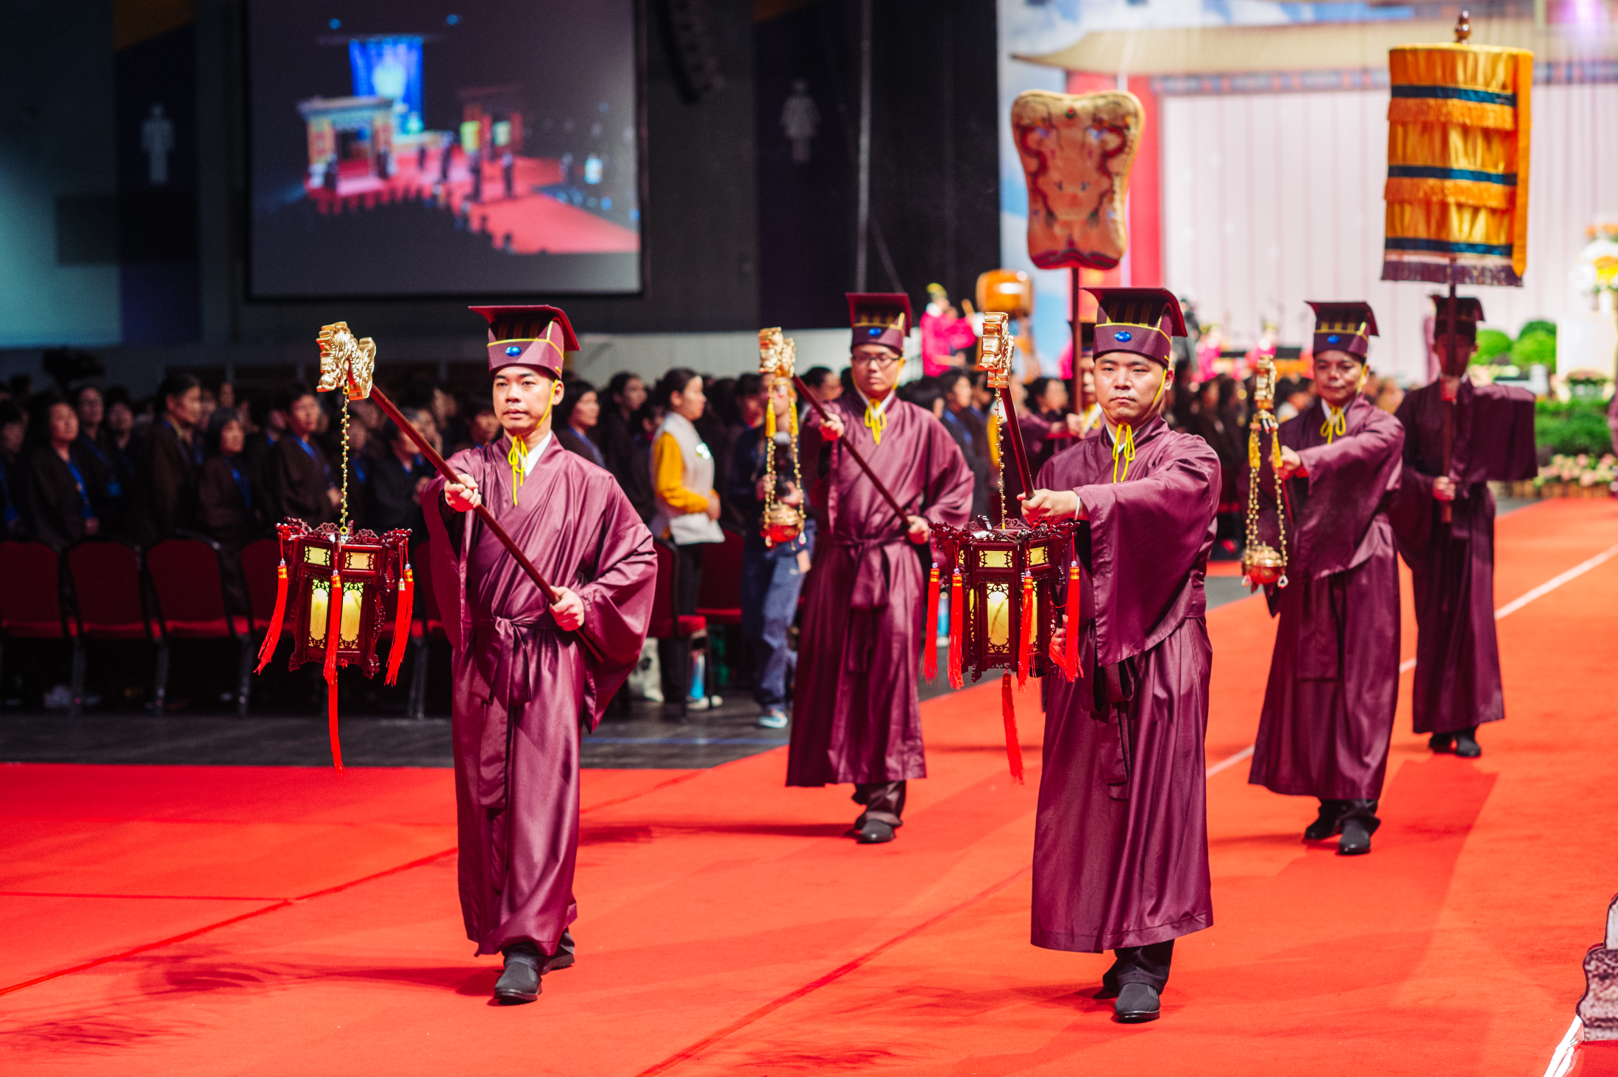
Notes:
That is why the Chinese emphasise the tradition of remembering their ancestors. Some people cannot see the point of doing so. They say, ‘You do not even know your ancestors from several hundred years ago. Why do you still hold remembrance ceremonies for them?’

Slide 13
Let there be careful attention to performing the funeral rites to parents, and let them be commemorated with ancestral remembrance ceremonies. Through this, the people will recover their innate virtue.
—— Analects of Confucius
慎终追远，民德归厚矣。
—— 《论语·学而》
Notes:
The Analects of Confucius explains, ‘Let there be careful attention to performing the funeral rites to parents, and let them be commemorated with ancestral remembrance ceremonies. Through this, the people will recover their innate virtue.’ If we can organise our parents’ funerals carefully and remember our ancestors, social customs will naturally become honest.
Why is this? If a person always keeps their ancestors in mind and can commemorate them regularly, how can they possibly not look after their parents? It is unlikely that they would remember their ancestors and disrespect their parents at the same time.
Therefore, commemorating ancestors fosters one’s awareness of kindness of others and develops one’s sense of gratitude.

Slide 14
昭述祖德，传承家风

Slide 15
All people in the world are our siblings.
—— Analects of Confucius
四海之内，皆兄弟也。
—— 《论语·颜渊》
Notes:
In reference to our elders, Confucianism talks of filial piety. In reference to our peers, the notion is extended to love amongst siblings. At its utmost, ‘all people in the world are our siblings’.

Slide 16
Extend across all time and space.
竖穷三际，横遍十方
Notes:
When we extend love for parents and siblings, we reach what is said in Buddhism as love that extends across all time and space.
Let’s take a look into this. What extends across time and space?

Slide 17
Heaven and earth coexist with me; all beings are one with me.
—— Zhuang Zi
天地与我并生，万物与我为一
——《庄子》
Notes:
This is also in line with what Zhuang Zi taught us – ‘Heaven and earth coexist with me; all beings are one with me.’
Only after we fully believe in the notion of one entity, can we truly practise equity and live in harmony with others.

Slide 18
Notes:
The true self is like the sea and the false self is like the bubbles in the water. Every bubble stubbornly thinks that this bubble is me and is even in conflict with other bubbles. But those who have returned to their self-nature discover that the whole ocean is their true self.
Hence, when we understand this truth, how would we ever be in conflict with others?

Slide 19
构建人类命运共同体的
理论基础

Slide 20
1、 仁者无敌
  仁者无敌 与 世界和平

Slide 21
The benevolent person makes no enemies.
The Works of Mencius (1A: 5)
仁者无敌。
《孟子•梁惠王上》

Slide 22
The Benevolence of Oneness.
  一体之仁。
Treat others as one would wish to be treated.
  己所不欲，勿施于人。

Slide 23
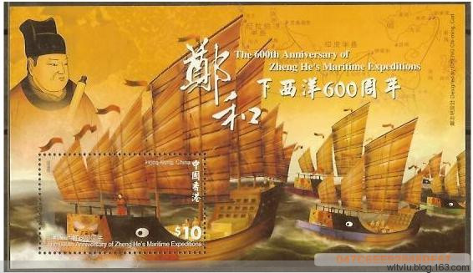
Zheng He’s seven voyages to the Western Seas
Zheng He (1371-1435)
a famous naval explorer of the Ming dynasty

Slide 24
Emperor Shun
舜帝
By mural painting from Han dynasty - Li Ung Bin, Outlines of Chinese History, Shanghai 1914, Public Domain, https://commons.wikimedia.org/w/index.php?curid=4297913
Notes:
Let us have a look at Emperor Shun.
Emperor Shun’s stepmother and stepbrother attempted to murder him many times, but he never held any grudges against them. Instead, he constantly reflected on himself and how he could do better in making his parents and stepbrother happy.
Eventually, he touched his stepmother and stepbrother as well as the community. He was later recommended to the emperor and ultimately Emperor Yao chose Shun as his successor.
People like Emperor Shun are called sages.

Slide 25
真正认识到一体是宇宙人生真相的人就是圣人，即回归自性、明明德的人。
Notes:
In Chinese, a person who has truly recognised the oneness, the truth of life and the universe is called a ‘sage’.
They have returned to their self-nature and have recovered their innate virtue.
The Emperors Yao and Shun are sage Kings.

Slide 26
The Way of the great Emperors Yao and Shun was simply the practice of filial piety and love among siblings.
—— Mencius
尧舜之道，孝弟而已矣。
—— 《孟子·告子下》
Notes:
It is said in the teachings of Mencius that ‘The Way of the great Emperors Yao and Shun was simply the practice of filial piety and love among siblings.’
Our love and respect for our parents and siblings is elevated to love for all, then the world will naturally be at peace.

Slide 27
化敌为友
Notes:
There is an old Chinese saying, ‘Turn enemies into friends’.
How do we do to achieve this?

Slide 28
唯天下至诚为能化
《中庸》
Notes:
By moving others with our sincerity.
The Doctrine of the Mean says, ‘Only utmost sincerity can reform others.’ Utmost sincerity can nurture and touch all beings. It can touch heaven and earth and of course human beings.
What happens when we do not follow the teachings of the sages, and instead resort to competition or conflict to deal with problems?

Slide 29
冤冤相报，没完没了
Notes:
Well, we find ourselves in the situation of ‘an eye for an eye’, an endless cycle of retaliation. As a result, the conflict inevitably escalates, both parties are hurt and the problems remain unresolved.

Slide 30
中华优秀传统文化的神奇作用就是能够达到人与人之间的和谐。
Notes:
The magical effect of traditional Chinese culture is to bring about harmony among human beings.

Slide 31
在这个世界上
没有我恨的人，
没有我不能原谅的人，
没有我不爱的人。
^{上}净^{下}空老教授
Notes:
As the Venerable Master Chin Kung once said, ‘there is no one in the world that I hate, there is no one in the world that I cannot forgive, there is no one in the world that I do not love’.

Slide 32
Culturally prosperous 文化的兴盛
The land of propriety 礼仪之邦
Khan of Heaven 天可汗
A universally recognised leader 王天下
Notes:
Therefore, all the golden ages in Chinese history were not only economically prosperous, but also culturally prosperous. It was traditional Chinese culture that enabled good governance of China in history.
This is why China has been known as ‘the land of propriety’ in the past and the Chinese emperors were respectfully called ‘Khan of Heaven’, which means ‘a universally recognised leader’ as they can set a good role model for others.
Love for one another, to the greatest extent, is global harmony. So, what does a harmonious world look like?

Slide 33
大道之行也，天下为公。
选贤与能，讲信修睦，
故人不独亲其亲，不独子其子。
《礼记·礼运》
Notes:
It is said in the Book of Rites, ‘The world belongs to its people. In a harmonious world, the virtuous and the capable are chosen to be leaders; trust and good neighbourliness is promoted. All people love and respect their parents and children as well as the parents and children of others.

Slide 34
使老有所终，壮有所用，
幼有所长，矜寡孤独废疾者，皆有所养。
Notes:
As a result, the elderly are cared for, adults realise their full potential, and the children are raised with care. Widows, widowers, orphans and the childless, people with disabilities, and those with illness, are all well taken care of.’
Is such a world not ‘the Chinese dream’ that people in China today are pursuing?

Slide 35
大同世界
互助（老吾老以及人之老，
幼吾幼以及人之幼。）
互爱（四海之内皆兄弟）
孝悌

Slide 36
世界上一些有识之士认为，包括儒家思想在内的中国优秀传统文化中蕴藏着解决当代人类面临的难题的重要啓示。
—— 习主席
Notes:
This is why at the International Conference in Commemoration of the 2565th Anniversary of Confucius’s birthday held in 2014, President Xi of China said,
‘There are people with vision in the world who think that the rich traditional Chinese culture, including the notions of Confucianism, can inspire us to resolve the serious problems that humankind today is facing.’
President Xi’s words are not without basis.

Slide 37
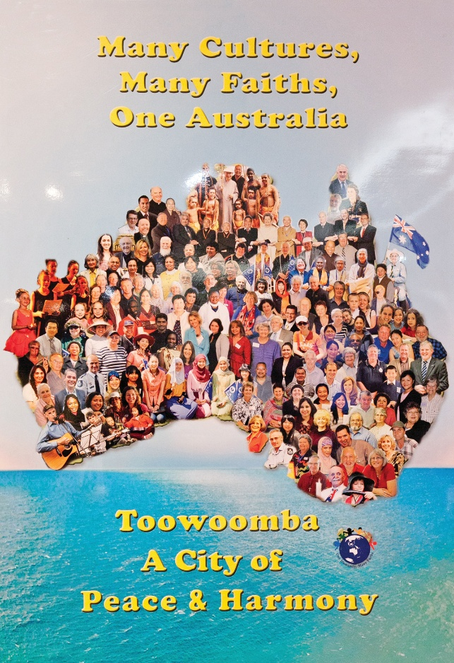
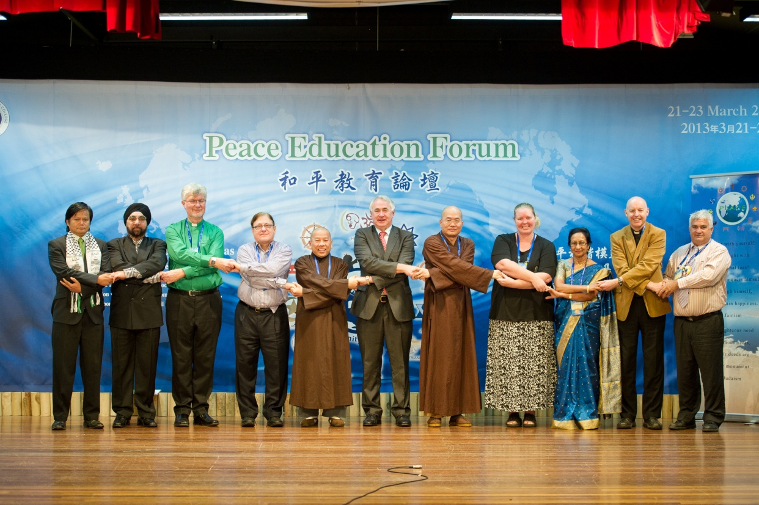
Faith leaders with the Mayor of Toowoomba (2013)
Notes:
In an increasingly diverse and divergent world, understanding the five relationships, and practising their related values, helps us resolve conflicts and differences from their roots. To enhance public confidence in peace and harmony, Venerable Master has been promoting interfaith and intercultural harmony, and has proved that the philosophy of Chinese traditional culture not only applies to a town in China, but also applicable to a multicultural cities outside of China, such as Toowoomba in Australia.

Slide 38
中国自古就提出了“国虽大，好战必亡”的箴言。“以和为贵”“和而不同”“化干戈为玉帛”“国泰民安”“睦邻友邦”“天下太平”“天下大同”等理念世代相传。中国历史上曾经长期是世界上最强大的国家之一，但没有留下殖民和侵略他国的记录。我们坚持走和平发展道路，是对几千年来中华民族热爱和平的文化传统的继承和发扬。
2014年3月在德国科尔伯基金会的演讲

Slide 39
古往今来，中华民族之所以在世界有地位、有影响，不是靠穷兵黩武，不是靠对外扩张，而是靠中华文化的强大感召力和吸引力。我们的先人早就认识到“远人不服，则修文德以来之”的道理。阐释中华民族禀赋、中华民族特点、中华民族精神，以德服人、以文化人是其中很重要的一个方面。
（2014年10月15日习近平总书记在文艺工作座谈会上的重要讲话）

Slide 40
故乱国之主，
务于广地，而不务于仁义，
务于高位，而不务于道德，
是舍其所以存，
而造其所以亡也。
《群书治要•文子》

Slide 41
2、天人合一
天人合一 与 可持续发展

Slide 42
夫大人者，
与天地合其德，
与日月合其明，
与四时合其序。
《群书治要•周易》

Slide 43
顺天者存，
逆天者亡。
孟子

Slide 44
民吾同胞；
物吾与也。
张载
Notes:
Zhang Zai, “The Western Inscription,” in Wing-tsit Chan, trans., A Source Book in Chinese Philosophy (Princeton, N.J.: Princeton University Press, 1963), 497.

Slide 45
大人者，
以天地万物为一体者也。
  王阳明
Notes:
Wang Yangming, “The Western Inscription,” in Wing-tsit Chan, trans., A Source Book in Chinese Philosophy (Princeton, N.J.: Princeton University Press, 1963), 659-660.

Slide 46
大人之能以天地万物为一体也，非意之也，
其心之仁本若是。

Slide 47
是故见孺子之入井，而必有怵惕恻隐之心焉，是其仁之与孺子而为一体也；孺子犹同类者也，见鸟兽之哀鸣觳觫，而必有不忍之心，是其仁之与鸟兽而为一体也；鸟兽犹有知觉者也，见草木之摧折而必有悯恤之心焉，是其仁之与草木而为一体也；草木犹有生意者也，见瓦石之毁坏而必有顾惜之心焉，是其仁之与瓦石而为一体也。

Slide 48
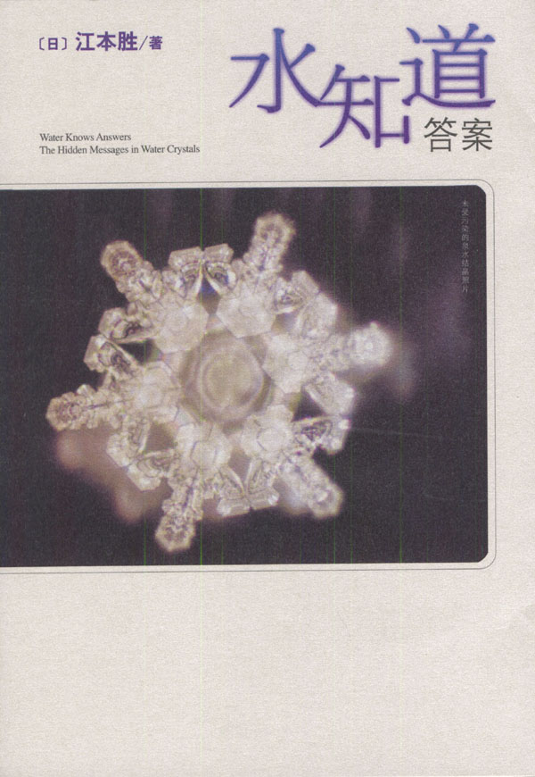

Slide 49
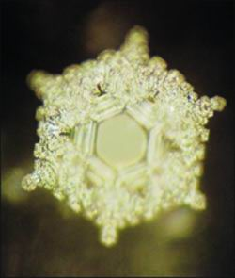
看过"爱与感谢"几个字的水所形成的结晶。这样的水结晶充满了喜悦，并形成 像盛开的鲜花一样的模样。

Slide 50
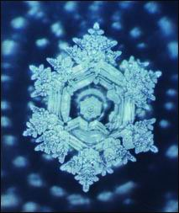
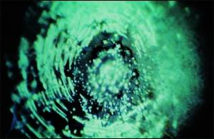
谢谢
混蛋

Slide 51
真正的风水在哪里？

Slide 52
夫损人而自益，身之不祥也；
弃老而取幼，家之不祥也；
释贤而任不肖，国之不祥也；
老者不教，幼者不学，俗之不祥也；
圣人伏匿，愚者擅权，天下不祥也。
《群书治要·孔子家语》

Slide 53
一切福田，不离方寸
福人居福地，福地福人居

Slide 54
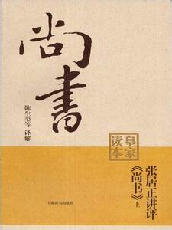
内作色荒，外作禽荒，
甘酒嗜音，峻宇雕墙，
有一于此，未或弗亡。
《群书治要•尚书》

Slide 55
布衣也，其友皆孝悌，纯谨畏令，如此者，家必日益，身必日安，此所谓吉人也；
事君也，其友皆诚信有行好善，如此者，事君日益，官职日进，此所谓吉臣也；
人主也，朝臣多贤，左右多忠，主有失，敢交争正谏，如此者，国日安，主日尊，天下日服，此所谓吉主也。
《群书治要•吕氏春秋》

Slide 56
巧夺天工

Slide 57
3、和而不同
  和而不同 与 合作共赢

Slide 58
万物并育而不相害，
道并行而不相悖。
《中庸》

Slide 59
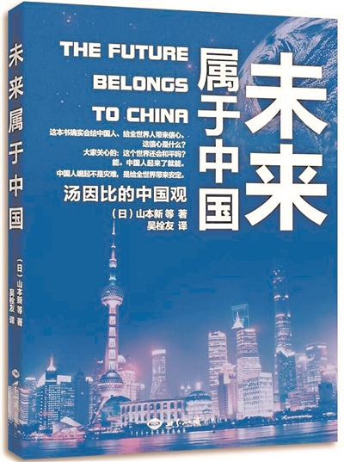
以中国为核心的东亚如果成为一体，这个东亚共同体将会成为未来世界的中坚力量。

Slide 60
